Slide 1
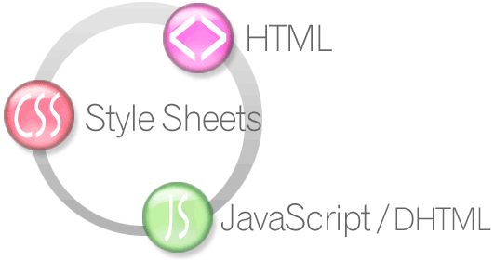

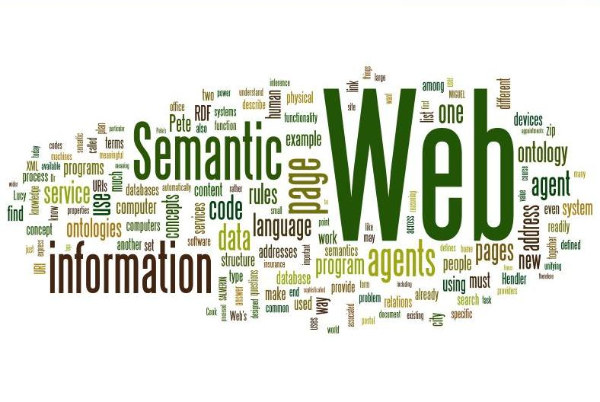
Semantic Web
How to Use HTML Elements Properly?
HTML5
Telerik Software Academy
http://academy.telerik.com

Slide 2

Table of Contents
Web Page
HTML, CSS and JavaScript
The Semantic HTML
HTML5 Semantic Tags
Other Semantics

Slide 3

Web Page

Slide 4
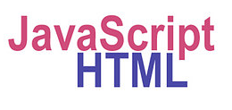
The Elements of a Web Page
A Web page consists of:
HTML markup
CSS rules
JavaScript code
JS libraries
Images
Other resources
Fonts, audio, video, etc…

Slide 5

The Elements of a Web Page: HTML Markup
The HTML is used to define the content of a Web page
Not the layout
Not the decorations
HTML's role is to present the information in a meaningful manner
Like a paper document
Define headers, paragraphs, textboxes, etc…
Not define size, color and/or positioning

Slide 6
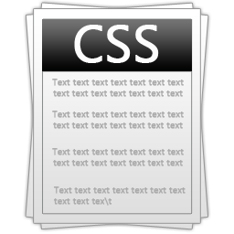
The Elements of a Web Page: CSS Rules
Cascading Style Sheets (CSS) is the way to make a Web page look pretty
Define styling rules
Fonts, colors, positioning, etc.
Define the layout of the elements
Define the presentation
The CSS files are attached to a web page and the browser applies these styles to elements

Slide 7

The Elements of a Web Page: JavaScript Code
JavaScript is the programming language for the Web
Makes the Web pages dynamic
Dynamically adding / removing HTML elements, applying styles, etc.
Modern JavaScript UI libraries provide UI components like dialog boxes, grids, tabs, etc.
Like CSS the JavaScript files are attached to a web page

Slide 8





The Elements of a Web Page: Other Resources
Other resources are needed for a Web page to run properly
Images, audio files, video files
Flash / Silverlight / ActiveX objects

Slide 9
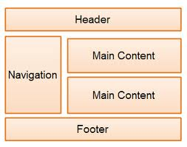
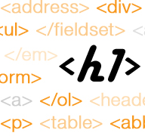
The Semantic HTML

Slide 10

Semantic HTML
Semantic HTML is:
The use of HTML markup to reinforce the semantics of the information in Web pages
Make the content understandable for computers
Rather than merely to define its presentation
A kind of metadata about the HTML content
Semantic HTML is processed by regular Web browsers and other user agents
CSS is used to suggest its presentation to human users

Slide 11


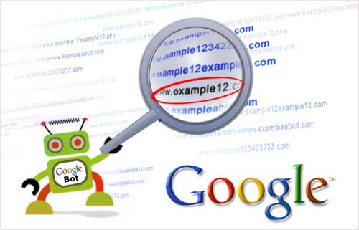
Why Use Semantic HTML?
Semantic HTML is:
Easier to read by developers
Easier to render by browsers
A way to show the search engines the correct content

Slide 12

How To Write Semantic HTML?
Just follow some guidelines when creating a Web site
Use HTML5 semantic tags
<header>, <nav>, <section>, <article>, <aside>, <footer>
Use Headings when you need to structure the content into sub-headings
In increasing order, staring with <h1>
Do not use empty tags
Like a clearing <div>

Slide 13

HTML5 Semantic Tags

Slide 14
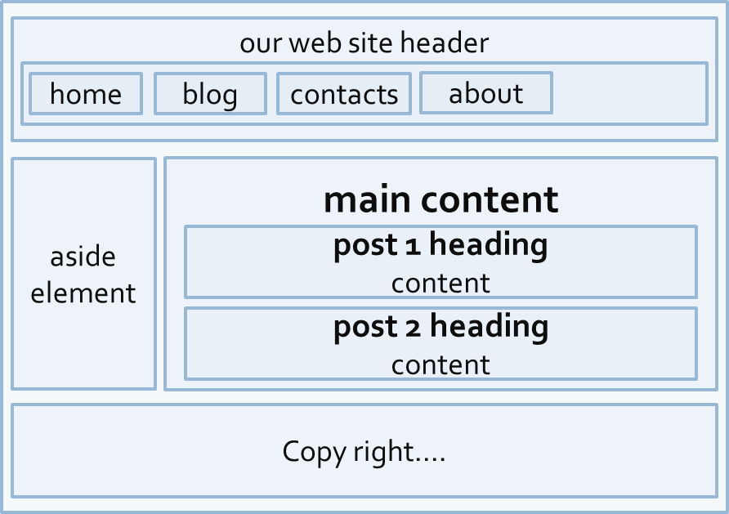
HTML5 Semantic Tags
HTML5 introduces semantic structure tags
Imagine the following site:
This is a common Web page structure
Used in 90% of the web sites

Slide 15
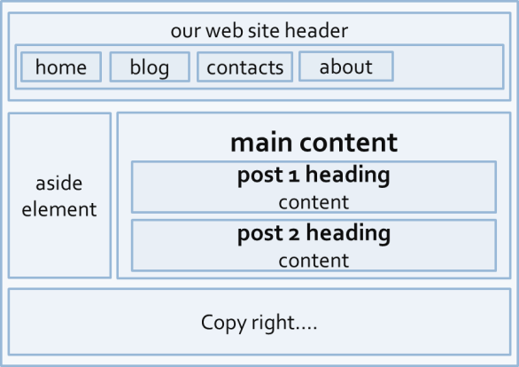
HTML5 Semantic Tags (2)
This can be created using all kind of HTML elements
<div>, <span>, even <p>
Browsers will render invalid / wrong / pseudo valid HTML
The correct way: use the HTML 5 semantic tags:
More about semantic tags: http://pavelkolev.com/html5-snippets/
<header> … </header>
<section> … </section>
<aside> … </aside>
<footer> … </footer>

Slide 16
HTML5 Semantic Tags (3)
<header>
Site header or section header or article header
<footer>
Site footer (sometime can be a section footer)
<nav>
Site navigation (usually in the header)
<section>
Site section (e.g. news, comments, links, …)
<article>
Article in a section (e.g. news item)

Slide 17
HTML5 Semantic Tags (4)
<aside>
Sidebar (usually on the left or on the right)
<figure>
Figure (a figure, e.g. inside an article)
<figcaption>
A caption of a figure (inside the <figure> tag)
<audio> / <video>
Audio / video element (uses the built-in player)

Slide 18
HTML5 Semantic Tags (5)
<details> + <summary>
Accordion-like widget (can be open / closed)
<hgroup>
Group article header + subheader (<h1> + <h2>)
<time>
Specifies date / time (for a post / article / news)

Slide 19
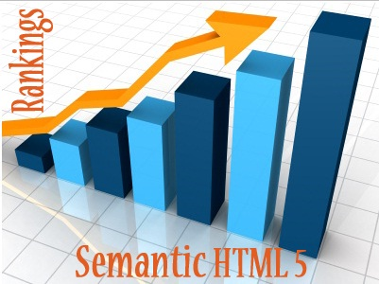
Other Semantics
Headings, ems, strongs

Slide 20
Other Semantics
Headings
Always use headings (<h1> – <h6>) when you need a heading or title
Like in a MS Word document
Google uses it to mark important content
Strong <strong> vs. Bold <b>
<b> does not mean anything
It just makes the text bolder
<strong> marks the text is "stronger" than the other, surrounding text

Slide 21
Other Semantics (2)
Emphasis <em> vs. Italic <i>
Emphasis does not always mean, that the code should be italic
It could be bolder, italic and underlined
The styles for the emphasis text should be set with CSS
Not by HTML
Old browsers (like IE6)?
Use Modernizr or HTML5shiv

Slide 22
Semantic Web
http://academy.telerik.com

Slide 23




Free Trainings @ Telerik Academy
"Web Design with HTML5, CSS3 and JavaScript" course @ Telerik Academy
html5course.telerik.com
Telerik Software Academy
academy.telerik.com
Telerik Academy @ Facebook
facebook.com/TelerikAcademy
Telerik Software Academy Forums
forums.academy.telerik.com

Slide 24
Homework
Refactor the refactoring-homework.html web page and make its HTML semantic
Create a web page using semantic HTML by the design in homework-design-1.pptx
Create a web page using semantic HTML by the design in homework-design-2.pptx
*Note: do not try to make the same styles in Exercise 2 and Exercise 3
Implement just the content with its semantics
Use some kind of approach to support old (non-HTML5-compatible) Web browsers like IE6-IE8

